Slide 1

Beyond The Hype 2.0 Hackathon Project Healthcare Pima Indian Diabetes Dataset Predictor
On Campus

Slide 2

Team Details
Team name: Bharat Innovators
Team Member name: Chaitanya Mangla (Individual participant)
Problem Statement: Open Innovation (Health Care)

Slide 3

HealthCare
Health care is one of the biggest issues in the whole world and especially, on the top of that the issue of Diabetes is the most prevalent and that too in India.
As we all know that Prevention is better than Cure. So, if any person comes to know about the probability of having diabetes before hand, then he can take precautions and prevent from the Diabetes to get worsen.
So, I, the member of Bharat Innovators, have built a Pima Indian Diabetes Dataset predictor based on Random Forest Classifier Machine Learning Algorithm which works on the concept of decision trees.

Slide 4
This project of mine is different from any other projects as its based on healthcare which is the most important thing in the world as its well said that ‘Health is Wealth’.
It can solve the problem as it can tell a person whether he or she is having the probability of being diabetic or not. So, accordingly he can take precaution.
If we go on the google, then we don’t see too much predictors and a little bit of them are there and they also charge for money. But this is free of cost with 82% accuracy.

Slide 5
The features offered in the solution include :
Diabetes Predictor (Predicts presence or absence of diabetes )
Diabetes Probability Predictor ( Predicts the probability of diabetes)
There are predictions made on 8 features : Pregnancies(Females), Glucose, Blood Pressure, Skin Thickness, Insulin, BMI, Diabetes Pedigree Function and Age.
The Google Technologies mainly used include :
Stream lit Cloud Community built on Google Cloud Platform
Kaggle for importing the dataset of Pima Indian Diabetes
Used Google search and chat GPT for gaining knowledge about the codes and ML models.
Also tried using the Google collab for coding.

Slide 6
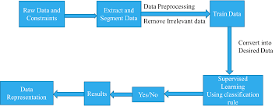
Process flow diagram or Use-case diagram

Slide 7
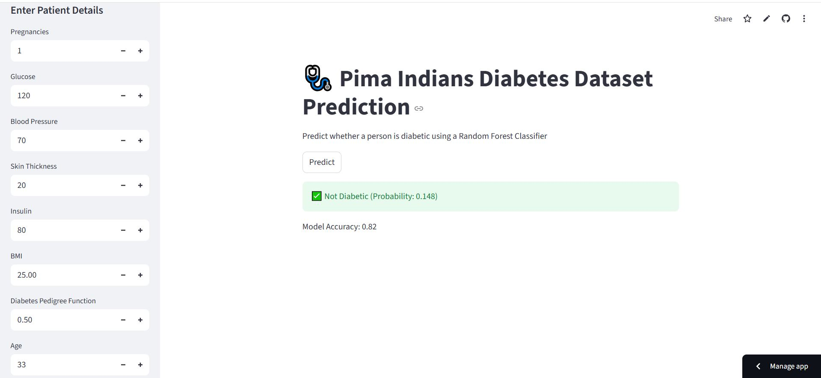
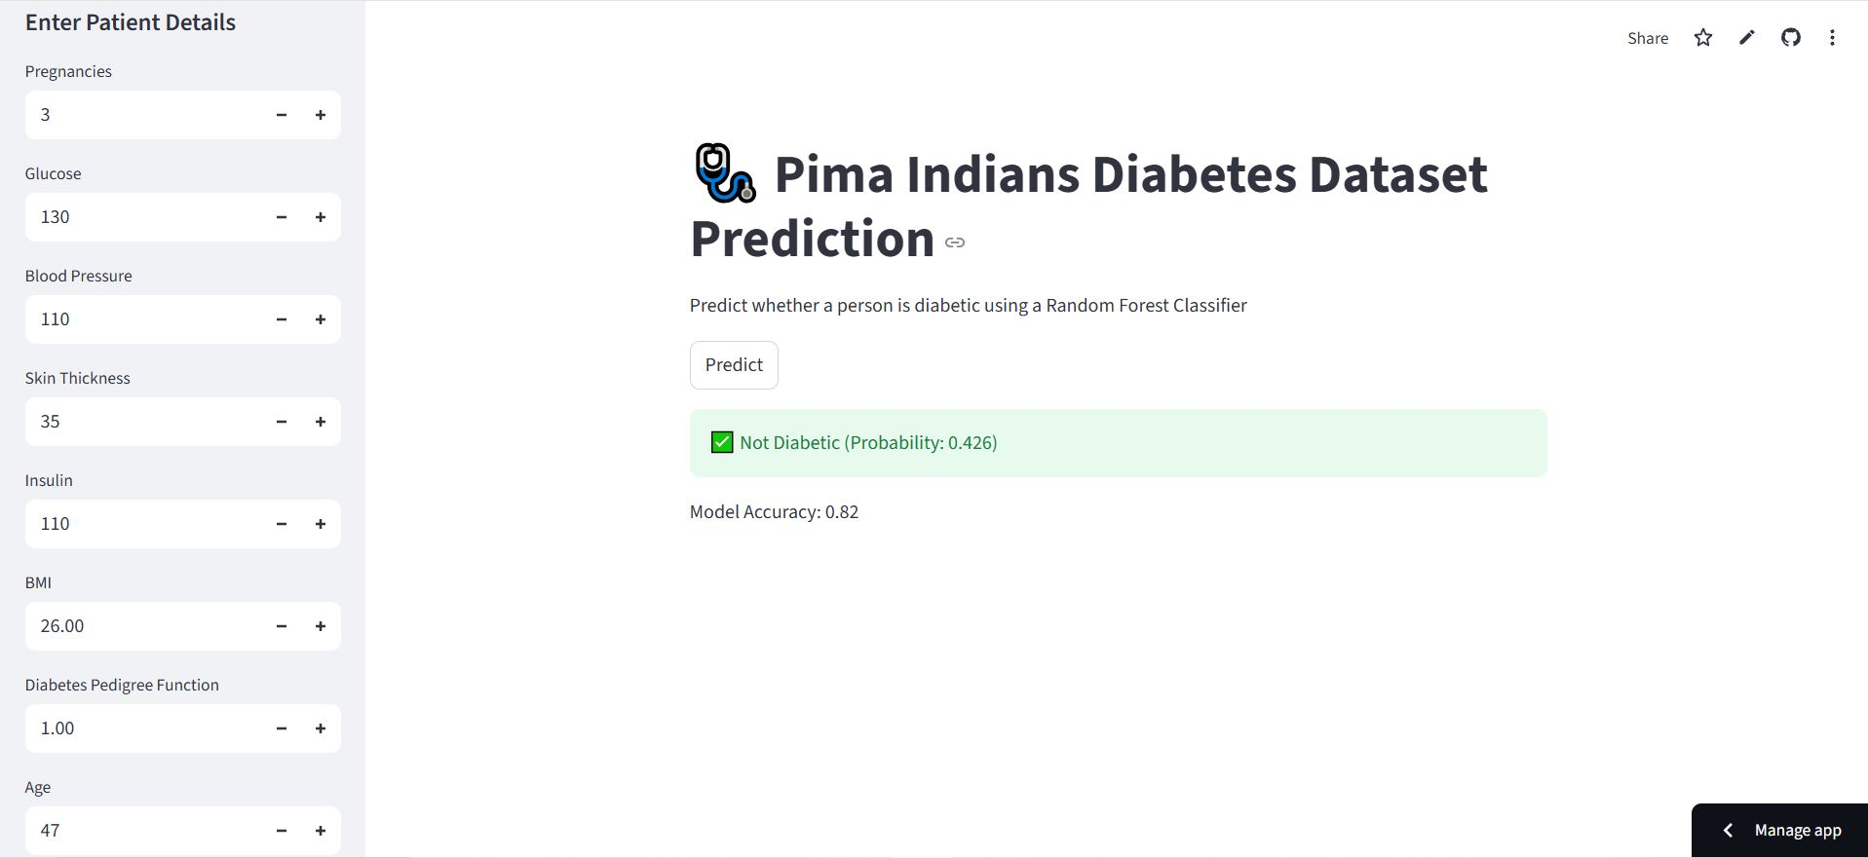
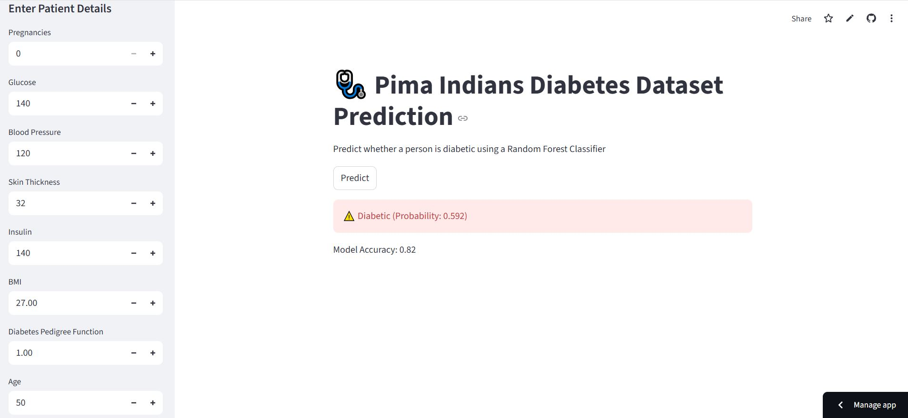

UI Screenshots

Slide 8
Provide links to your:
GitHub Public Repository : Github Link
Demo Video Link (3 Minutes) : Video Link
MVP Link : Streamlit Link

Slide 9

Thank you!

